Slide 1
The Relational Model
Instructor: Rodica Neamtu
rneamtu@wpi.edu

Slide 2





Relational Model
Another model for describing your data and application requirements
Currently the most widely used model

Slide 3
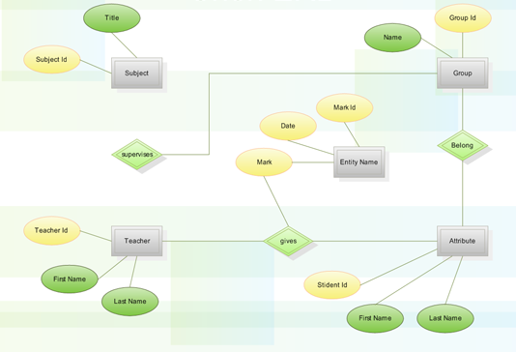
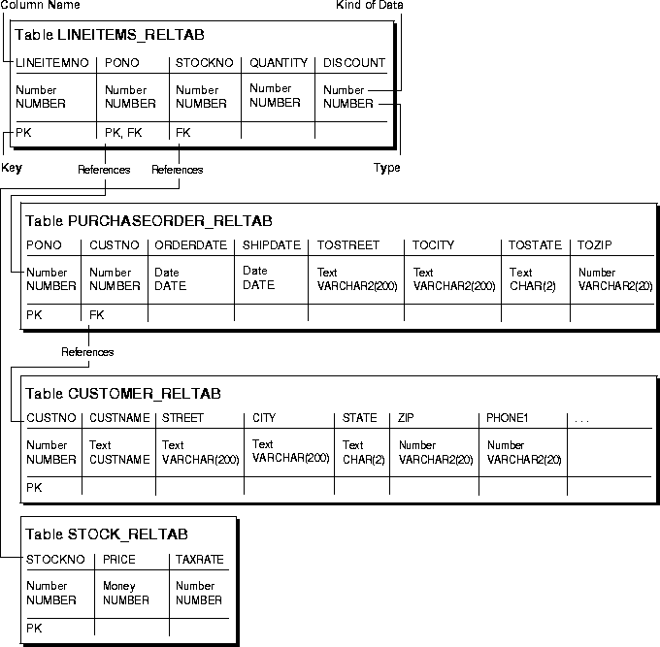
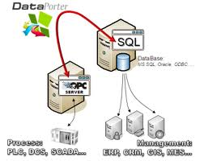
Design and Build Phases
Phase 1
Phase 2
Phase 3
ER Model & ERD
Build the database
Relational Model

Slide 4
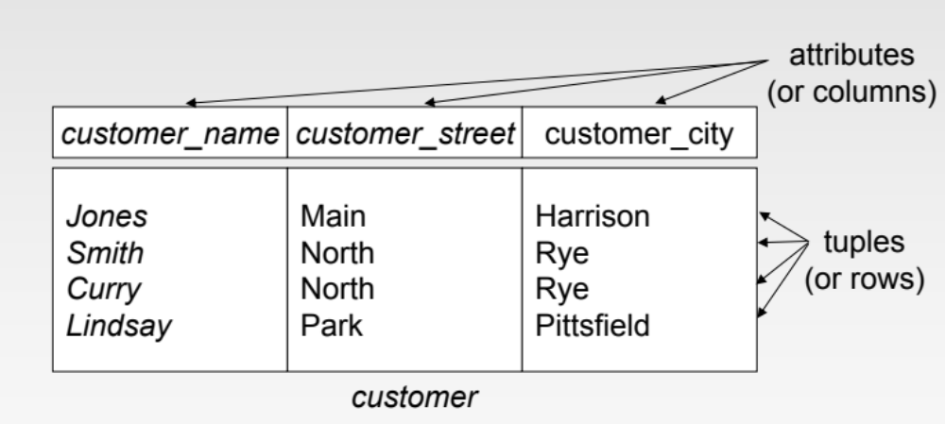
Relational Model
Structure:
  Relations (also called Tables)
  Attributes (also called Columns or Fields)

Slide 5
Attributes in Relational Model
Attribute Name
  Each attribute of a relation has a unique name within the relation
Attribute Domain
  The set of allowed values for each attribute is called the domain of the attribute
  E.g., integer, real, date, string, etc.
Atomic Attributes
  Attribute values are required to be atomic
  (primitive or derived)
  Note: multivalued attributes are not atomic
  Note: composite attributes are not atomic
  We will see how to handle non-atomic attributes
Special Null Value
  The special value null is a member of every domain
  The null value means the values does not exist (unknown)

Slide 6

Relational Schema
Schema is the structure of the relation
Attributes A1, A2, ..., An of relation R
  R=(A1,A2,...,An ) is the schema of relation R
Relational Schema of “customer” is
  customer = (customer_name, customer_street, customer_city)
  customer (customer_name, customer_street, customer_city)

Slide 7
Relational Instance
Instance is the current schema plus the current tuples in the relation
The current instance of “customer” has four tuples (rows or records)
Instances are frequently changing
  E.g., inserting new tuples, deleting or updating existing tuples
Schemas may also change but not frequently

Slide 8
Arity & Cardinality of Relations
Arity (Degree) of a relation
  Number of attributes of that relation
Cardinality of a relation
  Number of tuples in that relation
Arity = 3
Cardinality = 4

Slide 9
Relations are Unordered
Order of tuples is not important
Order of columns is not important
Think of a relation as a set (or bag) of tuples not as a list of tuples
  Most current DBMSs allow bags
Student
Student
Student
sNumber | sName
1 | Dave
2 | Greg
sNumber | sName
2 | Greg
1 | Dave
sName | SNumber
Greg | 2
Dave | 1
These relations are equivalent

Slide 10

Keys of Relations
Super Keys
  Subset of attributes that uniquely identify each tuple
Candidate Keys
  Minimal super key
Primary Keys
  Choose any of the candidate keys
  Represented by “underline” under the selected attributes
Set vs. Bag
  If a relation has a primary key, then it is a set not a bag
Assuming the customer name is unique
  customer (customer_name, customer_street,
  customer_city)

Slide 11
To create these relations (tables)
We use SQL

Slide 12
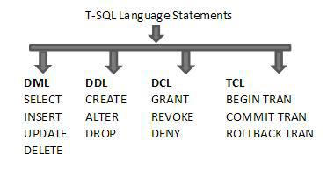
SQL Language
Data Definition Language (DDL)
  Create tables, specifying the columns and their types of columns, the primary keys, etc.
  Drop tables, add/drop columns, add/drop constraints – primary key, unique, etc.
Data Manipulation Language (DML)
  Update, Insert, Delete tuples
  Query the data

Slide 13
DDL ---- Creating Relations
Create “Students” relation
Create “Courses” relation
CREATE TABLE Students
(sid CHAR(20),
name CHAR(20),
login CHAR(10),
age INTEGER,
gpa REAL);
CREATE TABLE Courses
(cid Varchar2(20),
name Varchar2(50),
maxCredits integer,
graduateFlag char(1));
Create “Enrolled” relation
Observe that type (domain) of each field is specified
Types are enforced by DBMS whenever tuples are added or modified
CREATE TABLE Enrolled
(sid CHAR(20),
cid Varchar2(20),
enrollDate date,
grade CHAR(2));
Notes:
15

Slide 14
Domain Types in SQL
String Data:
  char(n): Fixed length character string, with user-specified length n
  varchar2(n): Variable length character strings, with user-specified maximum length n
Numbers:
  int: Integer
  Real: floating point number
  Number(p,s): Number with precision p and scale s
Boolean:
  Make it char(1) [Y/N or T/F], or number(1) [1/0]
Date & Time:
  Date: Date field with certain format
  Timestamp: Date plus time with a certain format
  customer (name: varchar2(100), DoB: Date, Phone: Char(10), …)

Slide 15
Dropping & Altering Tables
Dropping (Deleting) a table
  DROP TABLE <tableName>;
Altering a table to add a column
  ALTER TABLE <tableName> ADD <col> <type>;
  The initial value of the column is Null
Altering a table to drop a column
  ALTER TABLE <tableName> DROP COLUMN <col>;
  Some DBMSs do not support dropping columns

Slide 16
Integrity Constraints (ICs)
IC: condition that must be True for any instance of the database
    ICs are specified when schema is defined
    ICs are checked when relations are modified
A legal instance of a relation is one that satisfies all specified ICs.
    DBMS should not allow illegal instances.
Examples:
  Student ID must be unique
  The combination of first + middle + last names must be unique
  The grade must be one of ( A, B, C, D)
  Account balance must be >= 0

Slide 17
IC: Key Constraints
Two types of key constraints can be defined
  Primary Key
  Unique (The other candidate keys)
Each relation may have only one primary key but, possibly many unique keys
Primary key attributes do not accept Null, Unique attributes accept Null
Create “Students” relation
Create “Courses” relation
CREATE TABLE Students
(sid CHAR(20) Primary Key,
name CHAR(20),
login CHAR(10) Unique,
age INTEGER,
gpa REAL);
CREATE TABLE Courses
(cid Varchar2(20) Primary Key,
name varchar2(50),
maxCredits integer,
graduateFlag char(1));

Slide 18
IC: Key Constraints (Cont’d)
Another way to define Keys
CREATE TABLE Students
(sid CHAR(20),
name CHAR(20),
login CHAR(10),
age INTEGER,
gpa REAL,
Constraint pk_sid Primary Key (sid),
Constraint u_login Unique (login));
Create “Students” relation
Arbitrary name you give it to the constraint
A relation can have only one primary key, but many unique keys
CREATE TABLE Enrolled
(sid CHAR(20),
cid Varchar(20),
enrollDate date,
grade CHAR(2),
Constraint pk_cols Primary Key (sid, cid, enrollDate));
Create “Enrolled” relation
That is how you define constraints on multiple columns

Slide 19
Example
CREATE TABLE Students
(sid CHAR(20),
name CHAR(20),
login CHAR(10),
age INTEGER,
gpa REAL);
Create “Students” relation with no constraints
Then add constraints…
Alter table Students add constraint StudentPrimaryKey Primary Key (sid);
Alter table Students add constraint StudentUnique Unique (login);

Slide 20
Not Null & Default Constraint Types
Create “Students” relation
Create “Courses” relation
CREATE TABLE Students
(sid CHAR(20),
name CHAR(20) NOT NULL,
login CHAR(10),
age INTEGER,
gpa REAL Default 0,
Constraint pk Primary Key (sid),
Constraint u1 Unique (login));
CREATE TABLE Courses
(cid Varchar2(20),
name varchar2(50),
maxCredits integer,
graduateFlag char(1) Default ‘Y’);
NOT NULL & DEFAULT constraints

Slide 21
Domain Values Constraint
Create “Enrolled” relation
CREATE TABLE Enrolled
(sid CHAR(20),
cid Varchar2(20),
enrollDate date,
grade CHAR(2),
Constraint pk Primary Key (sid, cid, enrollDate),
Constraint gradeVal check (grade in (‘A+’, ‘A-’, ‘B+’, ‘B-’)) );
Domain constraint

Slide 22
IC: Foreign Key Constraints
(Referential Integrity )
Create “Students” relation
Create “Courses” relation
CREATE TABLE Students
(sid CHAR(20),
name CHAR(20),
login CHAR(10),
age INTEGER,
gpa REAL);
CREATE TABLE Courses
(cid Varchar2(20),
name varchar2(50),
maxCredits integer,
graduateFlag char(1));
Foreign key
Foreign key
Create “Enrolled” relation
CREATE TABLE Enrolled
(sid CHAR(20),
cid Varchar2(20),
enrollDate date,
grade CHAR(2));

Slide 23
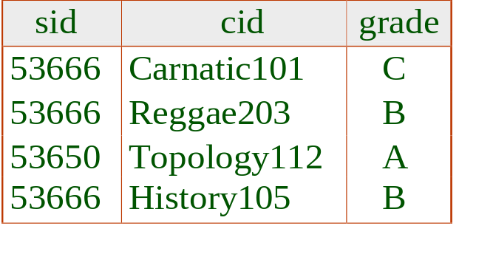
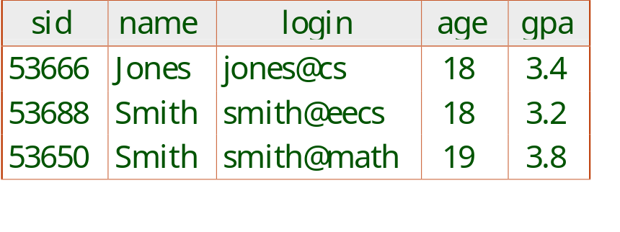
Foreign Keys, Referential Integrity
Foreign key : Set of fields in one relation that "refer" to a tuple in another relation (like a pointer)
Foreign key :
  FK in referencing relation must match PK of referenced relation.
  Match = same number of columns, compatible data types (column names can be different)
  The relationship is many-to-one from the “referencing” to the “referenced”
Enrolled (referencing relation)
Students (referenced relation)
Foreign Key
Primary Key
Notes:
7

Slide 24
Foreign Keys in SQL
Create “Students” relation
Create “Courses” relation
CREATE TABLE Students
(sid CHAR(20) Primary Key,
name CHAR(20),
login CHAR(10),
age INTEGER,
gpa REAL);
CREATE TABLE Courses
(cid Varchar2(20) Primary Key,
name varchar2(50),
maxCredits integer,
graduateFlag char(1));
Create “Enrolled” relation
CREATE TABLE Enrolled
(sid CHAR(20) Foreign Key References Students (sid),
X Varchar2(20),
enrollDate date,
grade CHAR(2),
Constraint fk_cid Foreign Key (X) References Courses (cid));
Two ways to define the FK constrain while creating a table
That is a third way
Alter Table Enrolled Add Constraints fk_cid Foreign Key X References Courses(cid));

Slide 25
Foreign Keys in SQL
Create “Students” relation
Create “Courses” relation
CREATE TABLE Students
(sid CHAR(20) Primary Key,
name CHAR(20),
login CHAR(10),
age INTEGER,
gpa REAL);
CREATE TABLE Courses
(cid Varchar2(20) Primary Key,
name varchar2(50),
maxCredits integer,
graduateFlag char(1));
Create “Enrolled” relation
CREATE TABLE Enrolled
(sid CHAR(20) Foreign Key References Students (sid),
X Varchar2(20),
enrollDate date,
grade CHAR(2),
Constraint fk_cid Foreign Key (X) References Courses (cid));
sid & cid have to be already defined as primary keys
Alter Table Enrolled Add Constraints fk_cid Foreign Key X References Courses(cid));

Slide 26
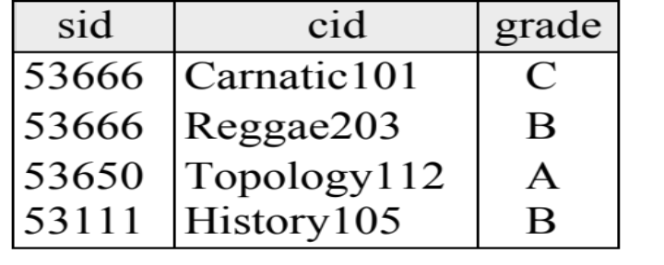
Violation of Foreign Key Constraints
Enrolled (referencing relation)
Students (referenced relation)
Foreign Key
Primary Key
Will be rejected
DBMS will prevent foreign key values that do not exist in the primary key column(s)

Slide 27
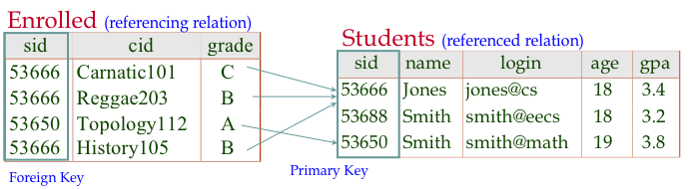
Enforcing Referential Integrity
Deletion: What if an Enrolled tuple is deleted?
  No problem. It is allowed
Notes:
13

Slide 28
Enforcing Referential Integrity (Cont’d)
Deletion: What if a Student tuple is deleted?
  Cascading -- Also delete all Enrolled tuples that refer to it
  No Action -- Disallow deletion of a Students tuple since there are dependent tuples
  Set Default -- Set sid in Enrolled tuples that refer to it to a default sid
  Set Null -- Set sid in Enrolled tuples that refer to it to a special value null, denoting `unknown’ (Not always applicable)
Same rules apply when updating Students.sid
The two most common actions are: Cascading or No Action
Notes:
13

Slide 29
Referential Integrity in SQL
SQL/99 supports all 4 options on deletes & updates:
CREATE TABLE Enrolled
(sid CHAR(20) Foreign Key References Students (sid),
cid Varchar2(20),
enrollDate date,
grade CHAR(2),
Constraints fk_cid Foreign Key cid References Courses (cid)
ON DELETE CASCADE
ON UPDATE NO ACTION);
Notes:
14

Slide 30
Relational Model: Summary
Structure
  Relations (Tables)
  Attributes (Columns, Fields)
Constraints + Constraint Enforcement
  Domain, Default, and Not Null Constraint
  Key Constraint
    Primary key, candidate key (unique)
  Foreign Key Constraint
SQL DDL commands

Slide 31
Inserting, Updating, Deleting Data
This is performed using Data Manipulation Language of SQL (DML)
Insertion (entire record)
  Insert into Students values (‘1111’, …);
Deletion (entire record)
  Delete from Students; //delete all students
  Delete from Students Where sid = ‘53666’;
Update (some attributes)
  Update Students Set GPA = GPA + 0.4; //update all
  Update Students Set GPA = GPA + 0.4 Where name = ‘Smith’;
Students

Slide 32

Advice….
Google is your best and fastest friend to get the SQL syntax you want…
  Make sure to search for “Oracle SQL ….”
  E.g., how a foreign key can consist of multiple columns

